Slide 1


Project 1: Netflix Genres Analysis
Georgia Tech Data Boot Camp: Group 1
Brian Hall | Daulton Davis | Hassan Mohamed
Joseph Johnson | Kelly Brown
Leon Lee | Orlvertta Moody
Valentina Zhu | Vedrana Basimamovic
This Photo by Unknown author is licensed under CC BY-ND.

Slide 2

Objective
Upper managements is concerned with a declining trend in subscriber count
Seeking answers on trends among four genres:
Action, Horror, Documentary, and Comedy.
Team is tasked with current content analysis among four genres using current Netflix data sets

Slide 3
Data set
Quantity of each genre (number of movies and shows)
Quality of each genre (IMDb average rating)
Most popular movie and/or show for the specific genre (TMDB)
Most featured actor/actress for the specific genre

Slide 4
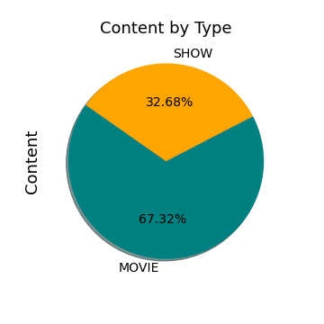
Data set
Release date from 1953 to 2022
Content by Type
Minimum IMDb score of 1.5 and max 9.5
TMDB Popularity score ranges from .6 to 1823.34
Notes:
TMDB – the movie database popularity score :
Number of votes for the day, views for the day, sers who marked it as a "favourite" for the day, users who added it to their "watchlist" for the day, release date, number of total votes, previous days score

Slide 5
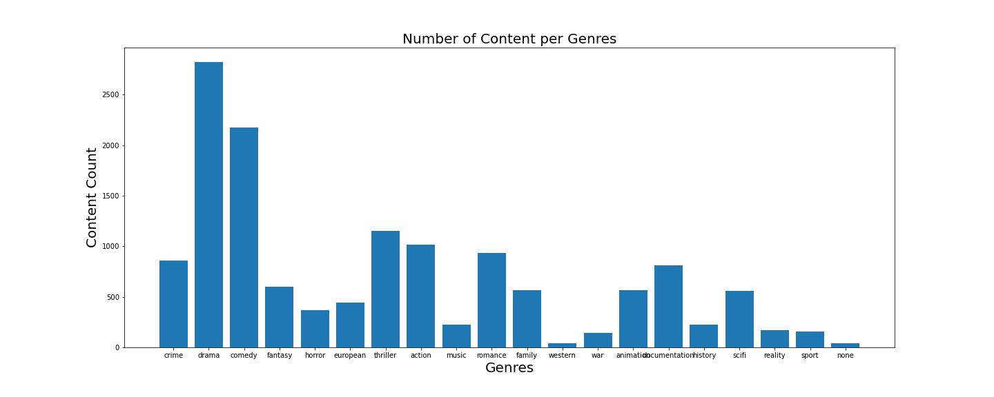
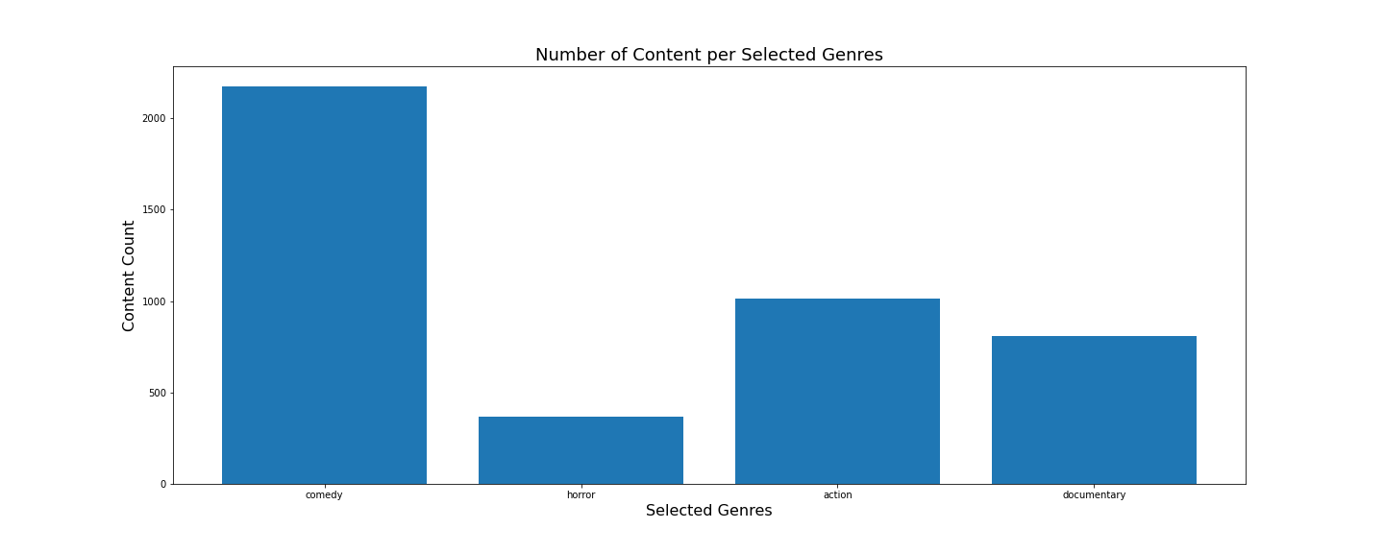
Top 5 genres:
Drama
Comedy
Thriller
Action
Romance
Selected Genres Count:
Comedy 40%
Horror 7%
Action 19%
Documentary 15%

Slide 6
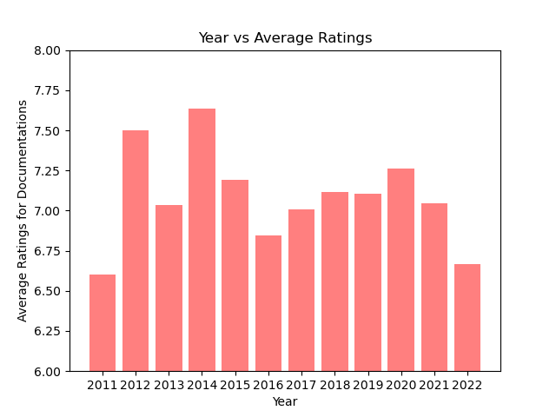
Documentary Data set
Total count of documentaries: 1688/10179
Genre of documentary makes up around 16% of movie and show market
From year 2012 to year 2022, ratings for documentaries have been fluctuating with a peak in year 2014.
Average IMDB rating for documentaries is 7.08, which is comparatively higher than other genres.
Notes:
TMDB – the movie database popularity score :
Number of votes for the day, views for the day, sers who marked it as a "favourite" for the day, users who added it to their "watchlist" for the day, release date, number of total votes, previous days score

